Slide 1
Open House
Wednesday, February 2, 2022

Slide 2
Welcome!
This virtual presentation features the many opportunities provided at Lincoln High School.
Thank you for supporting your student as they begin their high school journey. We look forward to having your student join our family.
Joseph Brady Hancock
Vice Principal
Lincoln High School
Go Trojans!
Back to “Homepage”

Slide 3
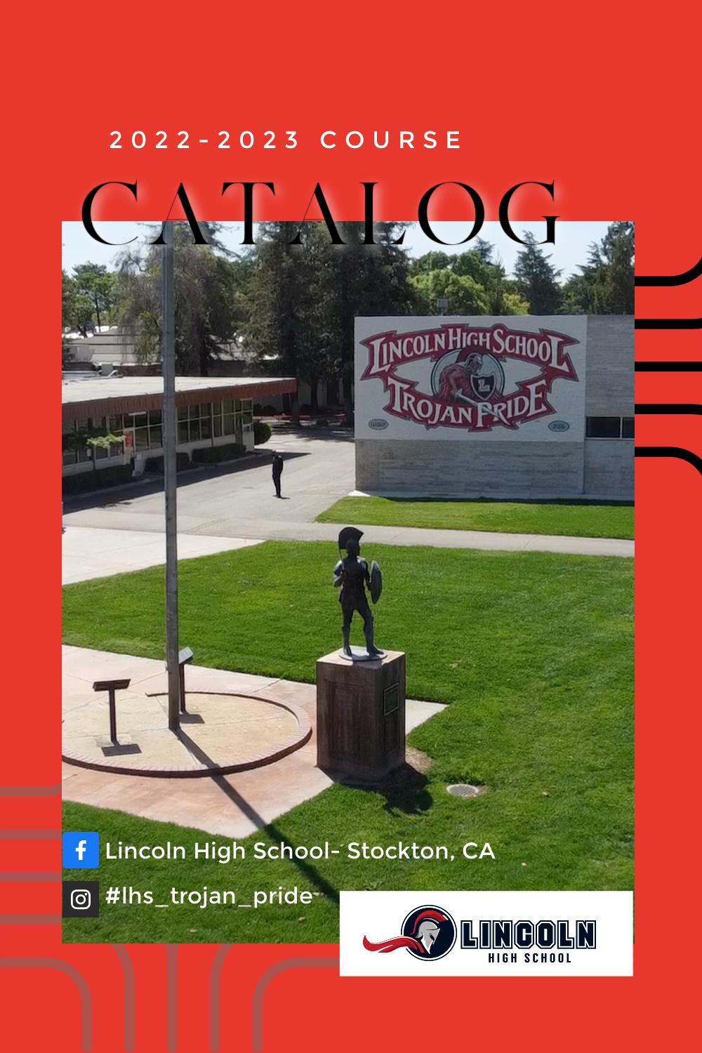
Registration Resources
2022-2023 LHS Course Catalog
Upcoming Dates
Feb 17th
Online Course Selection (Grades 9-11 LHS)
March 2nd-March 15th
Online Course Selection (8th grade sites)
Note: Individual 8th grade sites select the date within this window to register for classes online at their sites.
4-Year Planning Templates
Click on the appropriate box for your grade level; you will be prompted to make your own copy that you can fill in
Back to “Homepage”

Slide 4
Virtual Campus Tour
Virtual Campus Tour
Virtual Campus Tour

Slide 5
Homepage
General Information
Welcome
Registration Resources
Virtual Campus Tour
Course information
Math and Computer Science Department
CTE and NJROTC Courses
ASB and Clubs
Peer Mediation
English
English Language Development
PE
Science
Strategies
Visual and Performing Arts (VAPA)
Social Science
World Languages
AP/Honors Courses
Resources
Dual Enrollment
Multilingual Community Center
College and Career Center (CCC)
Additional Resources
4 year plan
8th grader (incoming 9th) parent presentation
Athletics/Cheer/Dance

Slide 6
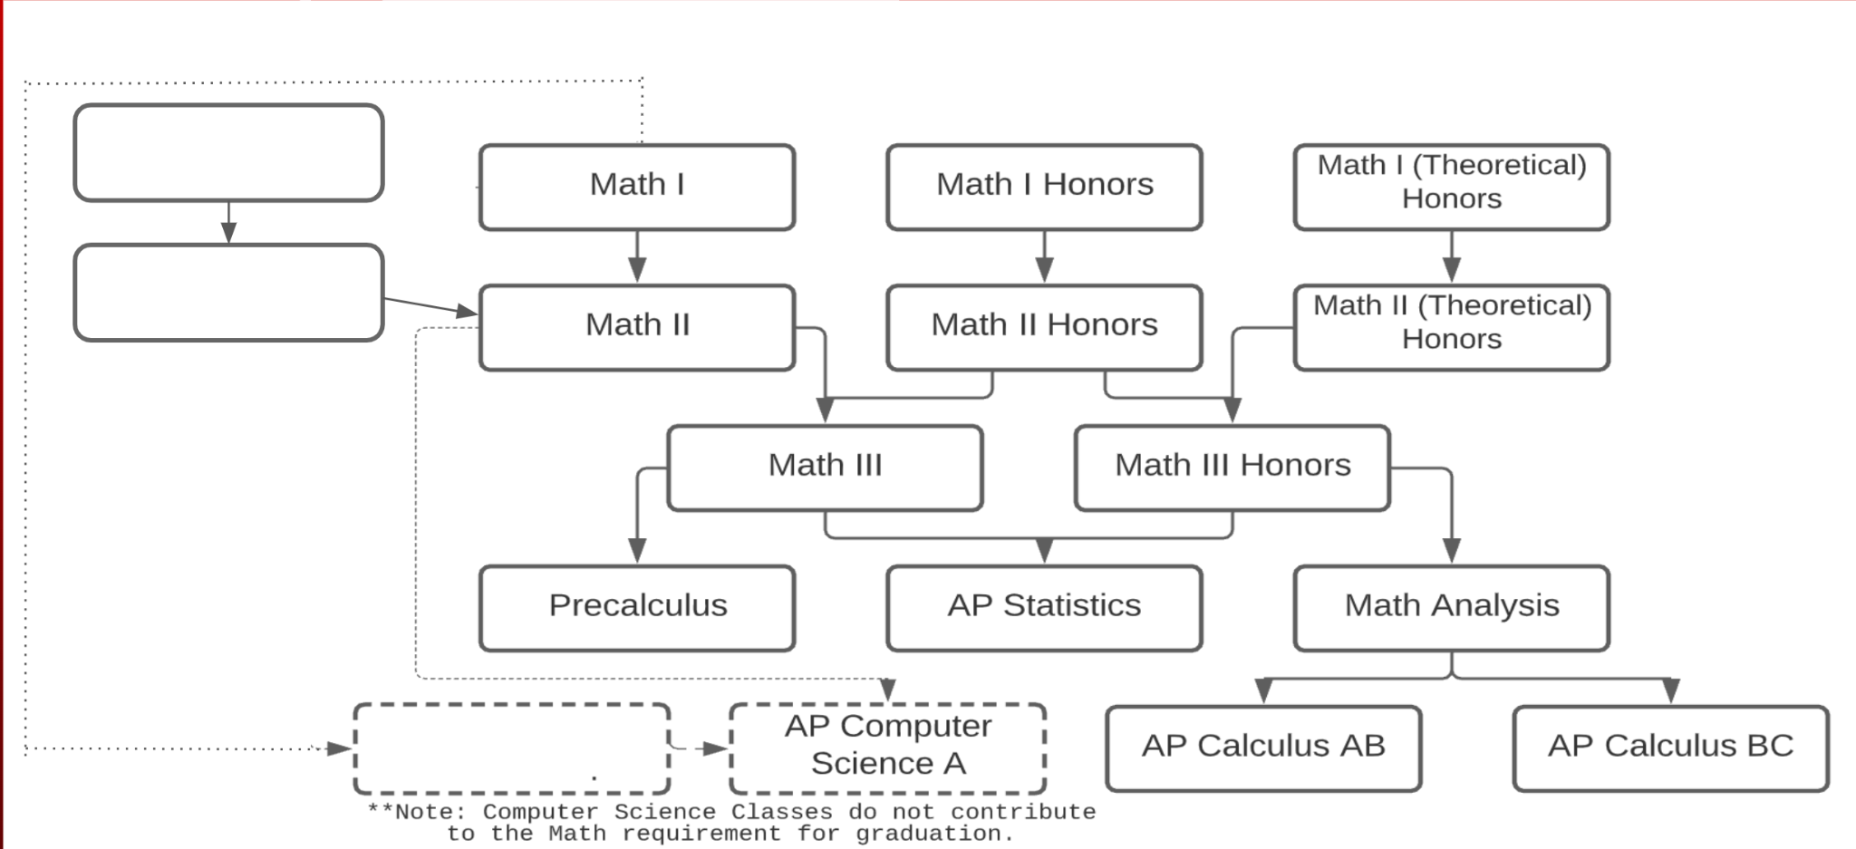
Math and Computer Science Department
Required: 20 Math credits (4 semesters, 2 years), Math I is required
Math I A
Math I
Math I Honors
Math I (Theoretical) Honors
Math I B
Math II
Math II Honors
Math 2 (Theoretical) Honors
Math III
Math III Honors
Precalculus
AP Statistics
Honors Analysis
AP Computer
Science Principles
AP Computer Science A
AP Calculus AB
AP Calculus BC
4th year math courses also on AP/Honors slide
Back to “Homepage”

Slide 7
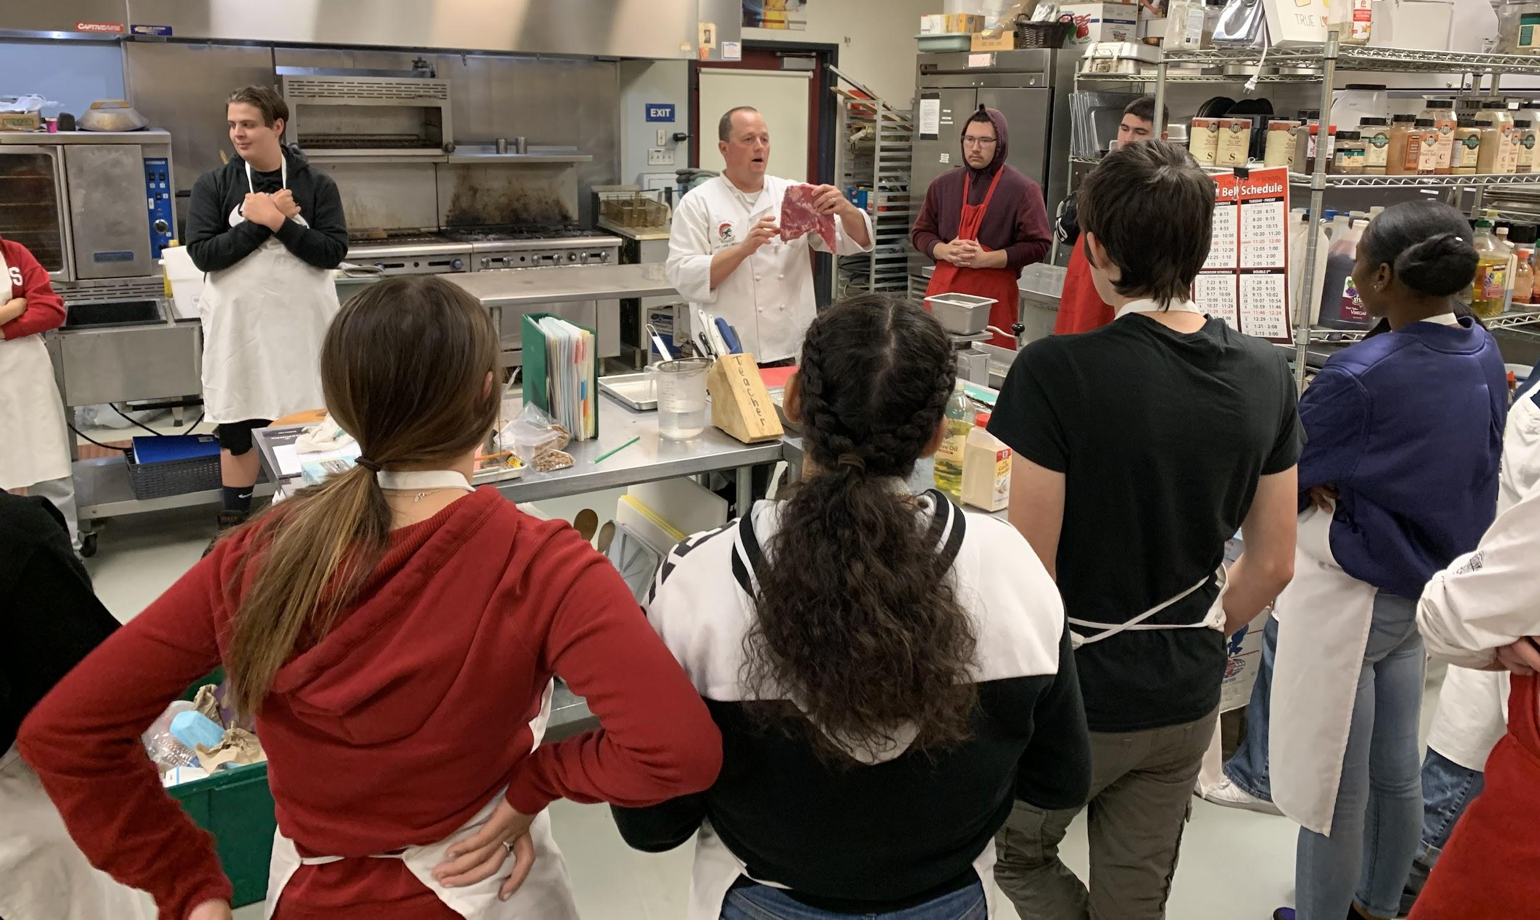
Career Technical Education (CTE)
- earn college credit at Delta while you’re in high school!
- hands-on learning!
- earn certifications that make you a viable candidate to work in the field
Education (Child Development)
Cabinetry, Millwork & Woodworking
Food Service & Hospitality
Fashion Design & Merchandising
Residential & Commercial Construction
Mechanical Systems Installation & Repair
Engineering Design
Architectural Design
Cisco Network Academy
Computer Programming
Web & Social Media Programming & Design
Back to “Homepage”

Slide 8
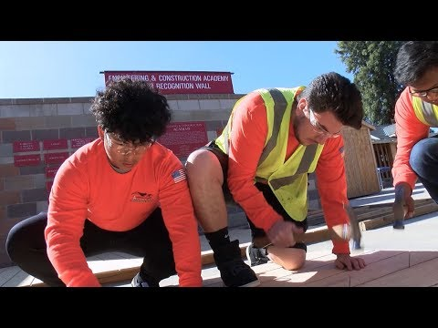
Career Technical Education (CTE)
LHS’ Engineering and
Construction Academy
Click to visit the ECA website
We offer the following Pathways:
Introduction to Construction and the Building Trades
Introduction, Intermediate, and Advanced Architecture, Engineering and Design
Introduction, Intermediate, and Advanced Cabinetry, Millwork and Woodworking
Intermediate, and Advanced Residential and Commercial Construction
Intermediate, and Advanced Mechanical Systems and Repair
Back to “Homepage”

Slide 9
Navy Junior Reserve Officer Training Corps
The purpose of NJROTC is to instill in Cadets the value of Citizenship, Team work, Self-Respect and Respect of others.
Back to “Homepage”

Slide 10
A Message from our current
Student Government-United Student Body (USB) Leaders
Back to “Homepage”

Slide 11
LHS Student Clubs Google Slides
Back to “Homepage”

Slide 12
Peer Mediation
WHAT IS PEER MEDIATION?
Wanna Stay In Touch or Have Questions?!
Please follow us on our new Instagram at
Lhs.peermediation
Or
contact Mrs. Cunningham at tcunningham@lusd.net
Back to “Homepage”

Slide 13
English Department
Required: 40 credits (enrolled in English classes all 4 years)
Throughout each of the four years in high school, English teachers will guide students to learn and build upon the nuances of the English language through a variety of informational and literary texts and activities rooted in the Common Core State Standards for English Language Arts and focused on speaking, reading, writing, and listening.
Grade 9
English 9 Curriculum Overview
English 9 Syllabus
Grade 11
American Literature or
Advanced Placement Language and Composition
Why Take AP Lang?
Grade 10
English 10 Syllabus
Grade 12
British/ World Literature or
Advanced Placement Literature and Composition (click me!)
Back to “Homepage”

Slide 14
English Language Development
ELD classes support the needs of students who are learning English at LHS. It is no easy task to become proficient in a new language and conquer the responsibilities of a high school student at the same time. The ELD teachers, along with the support of the Multilingual Community Center, provide support to students in their personal language goals to insure their needs are met. A variety of tools and curriculum are used in order for students to advance their English skills and prepare for the ELPAC exam. Ms. Singer and Mrs. Jackson teach ELD here at Lincoln High School and look forward to welcoming your students!
ELD Reading and ELD Language (grades 9-12)
These courses are designed for students who are new to the US or CA and are working toward speaking, reading, and writing English as their second language.
ELD Syllabus
Academic English (Grades 9-12)
Academic English is a support class that students who are English learners will take as one period of their day to support their growth in the English language.
Academic English syllabus
Questions? Please email Antonia Rosas in our MLCC at arosas@lusd.net or
Assistant Principal Marla Carrillo-Kelly at mcarrillokelly@lusd.net
Back to “Homepage”

Slide 15
English Department - Elective Courses
Journalism/Newspaper
Challenge your written creativity and improve writing skills
See your work published online
Research and analyze social issues on campus, in our community, in our state and inside our nation
Enhance your social networking and time management skills
Journalism is UC approved - “A-G”
Great on college applications
Check out our YouTube video:
https://www.youtube.com/watch?v=CToH-u_9C5Y
The Lincolnian (The Student Newspaper of LHS)
Yearbook
Oral Interpretation (Speech & Debate),
UC Approved- “A-G” (F)
-Grades 9-12
-Oral Interpretation is the art of giving life to words on a page. Students will learn to use their voice and body to interpret and recite pieces of dramatic literature, including speeches, poetry, prose, and plays.
-Students will build an appreciation for literature, spoken word, and performing arts
-Students will learn about different speaking events and compete in the Yosemite Forensics League (as well as become members of the California High School Speech Association CHSSA and the National Speech and Debate Association NSDA)
Rhetoric (Speech & Debate)- UC Approved- “A-G” (G)
-Grades 10-12
-Students learn to research and craft strong, persuasive arguments that relate to different national and international topics of debate.
-Students will learn to research and write persuasive arguments on topics of their choice in order to deliver informative speeches that advocate for awareness and change, as well as study effective speeches from world leaders.
-Students will use their analytical and critical thinking skills to compete in various speech and debate events in the Yosemite Forensics League (as well as become members of the California High School Speech Association CHSSA and the National Speech and Debate Association NSDA)
Back to “Homepage”

Slide 16
PE Department
Required: 20 credits (4 semesters = 2 years)
Physical Education
9 -12
Explore through sports.
It’s a great way to find an activity you love and a new friend.
Course Syllabus
Sports Activities
PE for Athletics 10-12
Aerobics 10-12
Course Overview
Weight Training 10-12
Weekly Schedule
Sports Leadership 11-12
Career Exploration
Personal Development
Back to “Homepage”

Slide 17
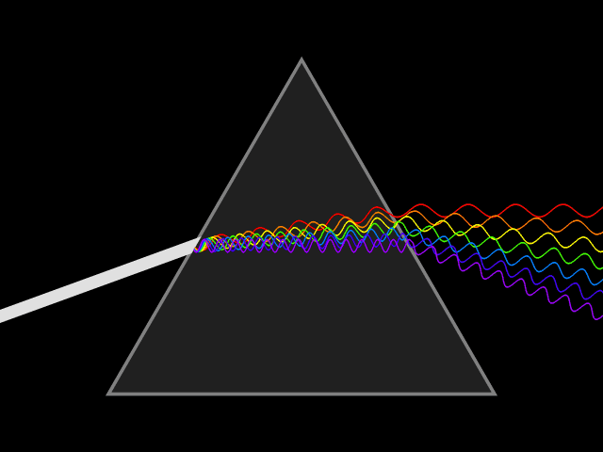
Science Department
Required: 20 credits (2 semesters, 2 years); 3 years recommended
Anatomy and Physiology
Biology (NGSS/Advanced)
AP Biology
Chemistry NGSS (Advanced/Honors)
AP Chemistry
AP Environmental Science
Physics (NGSS/Advanced)
AP Physics 1
AP Physics 2
Back to “Homepage”

Slide 18
Social Science Department
Required: 40 credits (enrolled in Social Science classes all 4 years)
Grade 9
Ethnic Studies
World Geography
AP Human Geography
Grade 10
Grade 11
United States History
AP U.S. History
Grade 12
American Government
Economics
AP U.S. Government and Politics
World History
AP World History
Electives:
Health Criminal Justice
Back to “Homepage”

Slide 19
Strategies Department
Enrollment in Strategies classes requires an Individualized Education Plan (IEP)
The goal of special education services in the Strategies Department is to provide the least restrictive and most appropriate education for students identified with an Individualized Education Program (IEP). Strategies students are provided with the opportunity to meet graduation, or Certificate of Completion, requirements in a variety of ways including: fully mainstreamed classes, collaborative mainstream classes and sheltered classes. The program of each Strategies student is individually developed with input from the IEP team. Only students with an IEP are allowed to take Strategies classes. Strategies students take classes either in the Resource Specialist Program (RSP) or Special Day Classes (SDC).
RSP Information
SDC Information
Strategies
Back to “Homepage”

Slide 20
VAPA Department - Visual & Performing Arts
10 credits of VAPA, or World Language, or CTE required for high school graduation
UC/CSU Approved Elective Opportunities (“f” & “g”)
Music
Visual Art
Choir
Orchestra
Band
Guitar
Piano
Honors Wind Ensemble
Honors Orchestra
Electronic Music
AP Music Theory
Art 1
Art 2 (3) Advanced
AP Studio Art Drawing
AP Studio Art 2D Design
Sculpture-Ceramics 1
Advanced Sculpture 2 (3-4)
Mixed Media
Mixed Media 2 (Advanced)
Visual Arts Showcase
Digital Arts
Theatre
Digital Video Production
Advanced Digital Video Production
Beginning Drama
Intermediate Drama
Advanced Drama
Musical Theatre
More on our Performing Arts programs here...
Back to “Homepage”

Slide 21
World Languages Department:
French, Italian and Spanish all have four year programs.
Two years of the same language are required for CSU/UC schools with three years highly recommended. Fulfills letter E of A-G requirements.
Learning a different language is learning a different vision of life.
Students can take several spanish paths: Spanish 1 or Spanish Speakers 1 → spanish 2 or Spanish Speakers 2 → spanish 3 or 3 honors → spanish 4 or AP spanish
Spanish 1 for Spanish Speakers
Spanish 1-4
Español 3 honores
AP Spanish Language and Culture
French 1-4
Italian 1-4
Perche` Italiano?
Back to “Homepage”

Slide 22
Advanced Placement (AP) and Honors Courses
SCIENCE
AP Biology
AP Chemistry
AP Environmental Science
AP Physics 1 AP Physics 2
Chemistry NGSS (Advanced/Honors)
ENGLISH
AP Language and Composition
AP Literature and Composition
WORLD LANGUAGES
Spanish 3 Honors
AP Spanish Language and Culture
COMPUTER SCIENCE
AP Computer Science Principles
AP Computer Science A
MATH
AP Statistics
AP Calculus AB
AP Calculus BC
Honors Analysis
SOCIAL SCIENCE
AP Human Geography
AP World History: Modern
AP U.S. History
AP U.S. Government and Politics
VAPA
AP Studio Art
Honors Wind Ensemble
Honors Orchestra
AP Music Theory
Back to “Homepage”

Slide 23
Dual Enrollment
Lincoln Unified Dual Enrollment
Students taking classes through the Delta College Dual Enrollment Program are able to receive both college credit and credit toward high school graduation.
Back to “Homepage”

Slide 24
Multilingual Community Center (MLCC)
The Multilingual Community Center offers to assist you with communication between EL students’ Parents/Guardians, Teachers and Counselors
Open Monday-Friday
Hours 8:00 AM - 4:30 PM
(209) 953-8947
Location: LHS Room 1116
Meet the Staff
Antonia Rosas
(209)953-8947
arosas@lusd.net
We are a resource center for the Second Language community in our district
We are a bridge between our EL parents and any department District wide
Check and monitor grades for EL students
Assist families in setting up Aeries accounts
Administer the English Proficiency Assessment for CA (ELPAC)
Veronica Campuzano
De Ramirez
(209)953-8942
vcampuzano@lusd.net
Welcome to Lincoln High School!
Back to “Homepage”

Slide 25
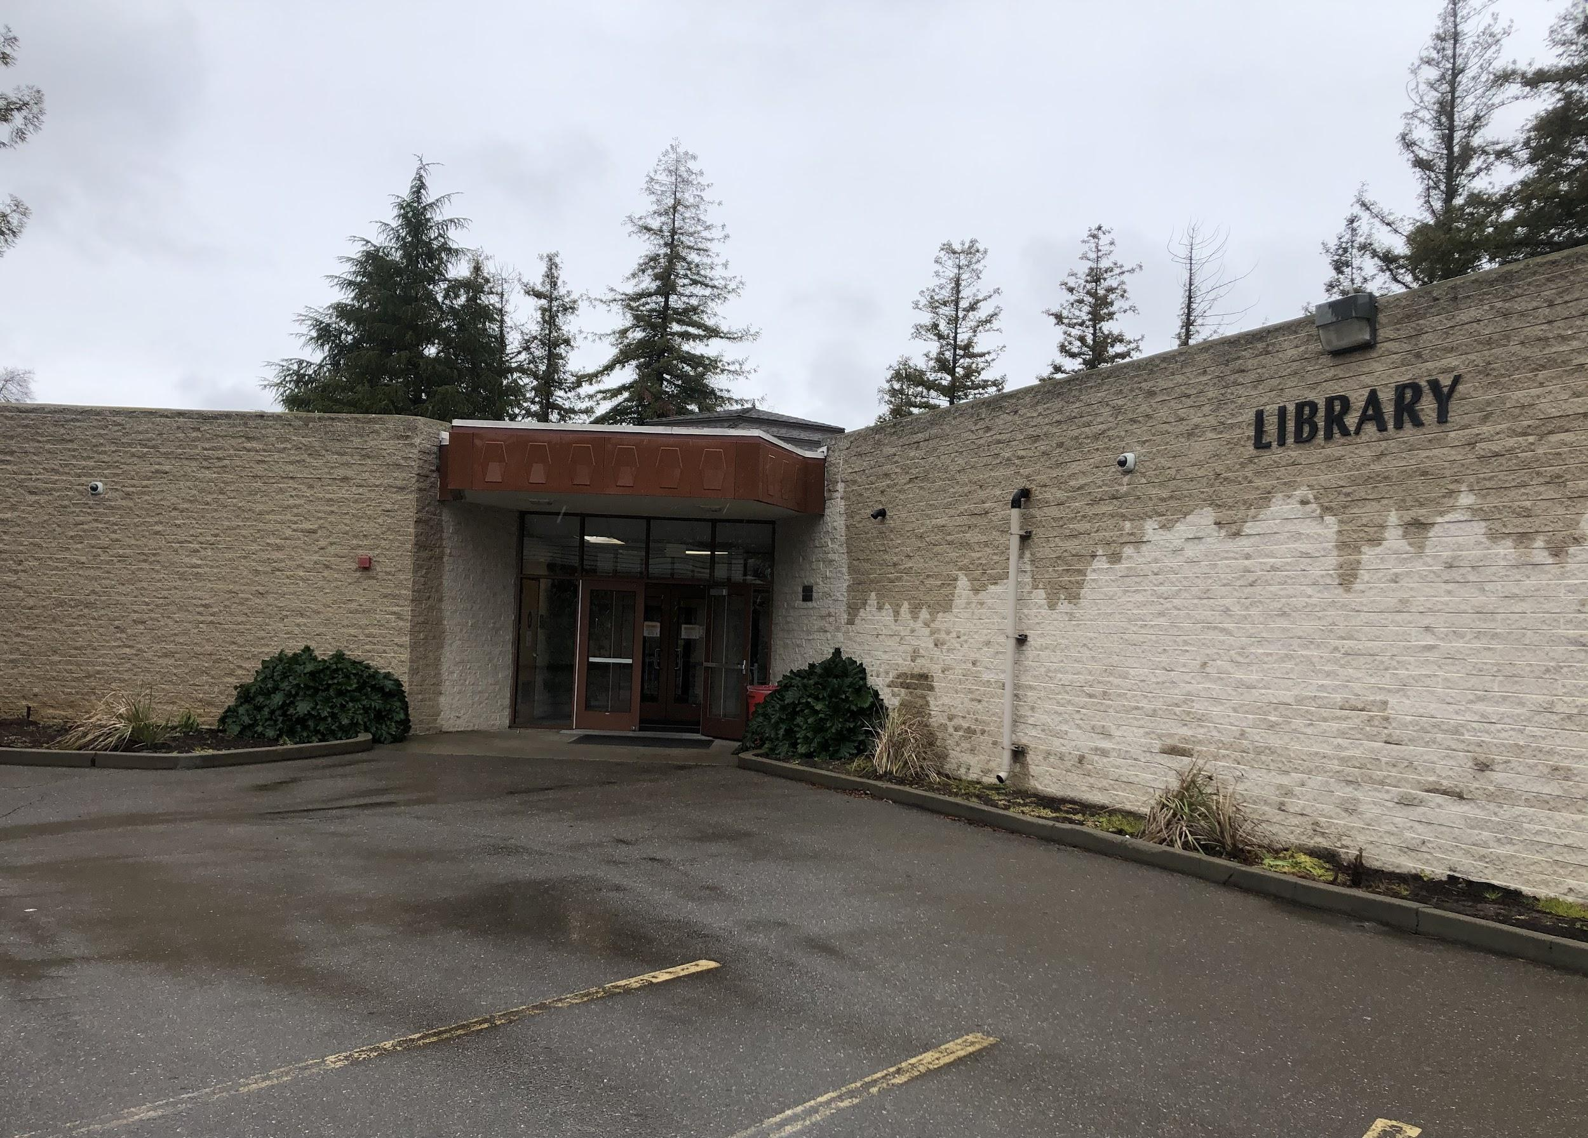
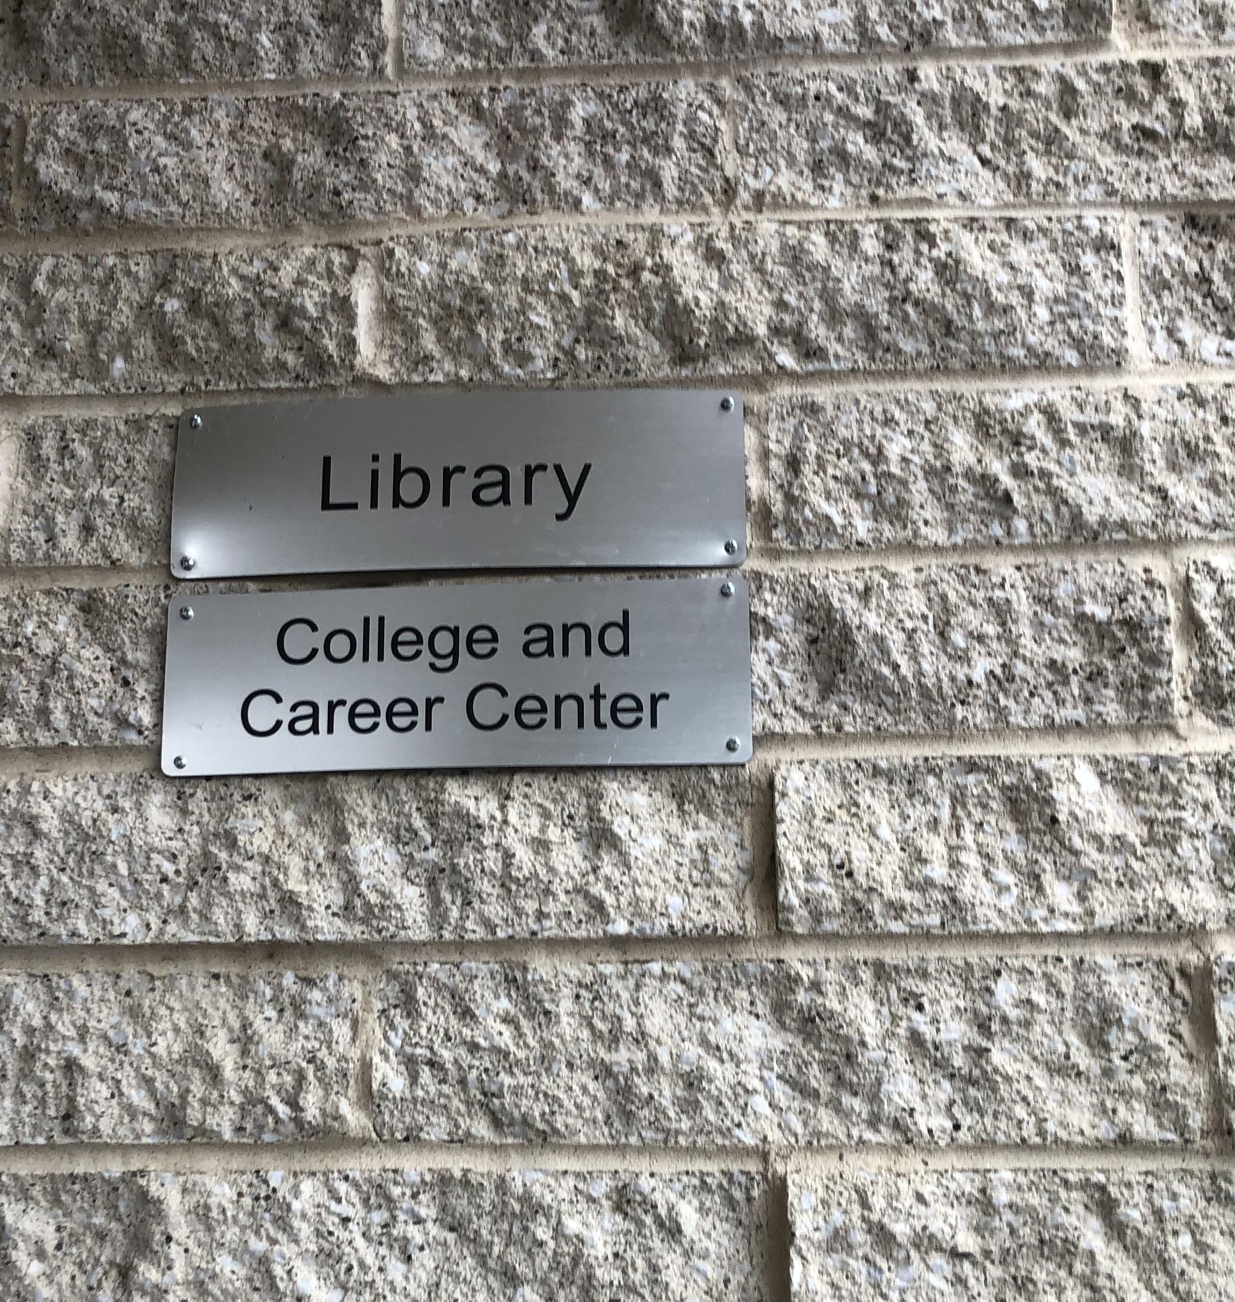
College & Career Center (CCC)
CCC Advisor
Resources
Mrs. Hernandez
College Application & Financial Aid Workshop
Senior Scholarship Opportunities
Contact Info
SAT/ACT & College application fee waivers
chernandez@lusd.net
209-953--8949
ASVAB (military) & Military Contacts
College Visits/Presentation (Virtual)
Location
Leadership Summer Camp Opportunities
Work permits
Trade School Information
inside the library!
Visit our CCC Website
Hours
Mon-Fri
11:20-Noon
& 1-4pm
Back to “Homepage”

Slide 26
Additional Resources
Pre-recorded Presentations
Athletics/Cheer/Dance
4 year plan
Presentation
Video
Math Pathways Presentation
Science Pathways Presentation
Back to “Homepage”

